Slide 1
Chapter 17 – Regression Based Forecasting
Data Mining for Business Analytics in R
Shmueli, Bruce, Yahav, Patel & Lichtendahl

Slide 2
Main ideas
Fit linear trend, time as predictor
Modify & use also for non-linear trends
Exponential
Polynomial
Can also capture seasonality

Slide 3
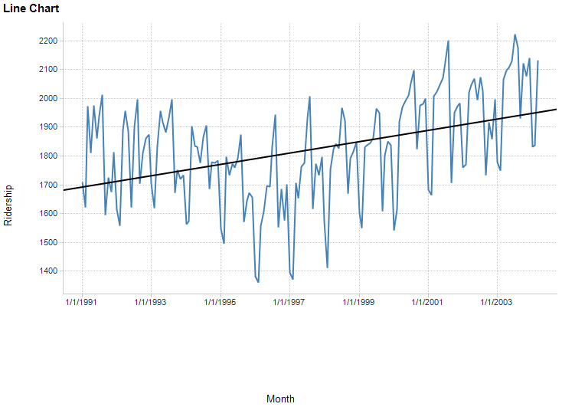
Linear fit to Amtrak ridership data (Doesn’t fit too well – more later)

Slide 4
The regression model
Ridership Y is a function of time (t) and noise (error = e)
Y_{i} = B₀ + B₁*t + e
Thus we model 3 of the 4 components:
Level (B₀)
Trend* (B₁)
Noise (e)
*Our trend model is linear, which we can see from the graph is not a good fit (more later)

Slide 5
function ts converts Amtrak .csv data into time series object
Although the original data have the time points, ts uses only the ridership data, and recreates the time points itself with start, end, and freq
library(forecast)
Amtrak.data <- read.csv("Amtrak.csv")
# create time series
ridership.ts <- ts(Amtrak.data$Ridership, start = c(1991,1),
end = c(2004,3), freq = 12)
# produce linear trend model
ridership.lm <- tslm(ridership.ts ~ trend)
# plot the series
plot(ridership.ts, xlab = "Time", ylab = "Ridership", ylim =
c(1300,2300), bty = "l")
lines(ridership.lm$fitted, lwd = 2)
trend is predictor variable created on the fly from the time series data
tslm fits linear model to data with time series components

Slide 6
Partitioning the data
nValid <- 36
nTrain <- length(ridership.ts) – nValid
# partition the data
train.ts <- window(ridership.ts, start = c(1991, 1),
end = c(1991, nTrain))
valid.ts <- window(ridership.ts, start = c(1991, nTrain + 1),
end = c(1991, nTrain + nValid))

Slide 7
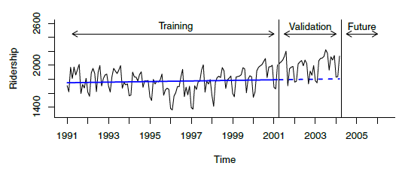
# fit linear trend model to training set and create forecasts
train.lm <- tslm(train.ts ~ trend)
train.lm.pred <- forecast(train.lm, h = nValid, level = 0)
Trend based on training data underestimates validation period

Slide 8
Plotting linear fit to ridership data (previous slide), and forecast errors (not shown)
fit linear trend model to training set and create forecasts
train.lm <- tslm(train.ts ~ trend)
train.lm.pred <- forecast(train.lm, h = nValid, level = 0)
par(mfrow = c(2, 1))
plot(train.lm.pred, ylim = c(1300, 2600), ylab = "Ridership", xlab =
"Time", bty = "l", xaxt = "n", xlim = c(1991,2006.25), main = "", flty = 2)
axis(1, at = seq(1991, 2006, 1), labels = format(seq(1991, 2006, 1)))
lines(train.lm.pred$fitted, lwd = 2, col = "blue")
lines(valid.ts)
plot(train.lm.pred$residuals, ylim = c(-420, 500), ylab = "Forecast Errors",
xlab = "Time", bty = "l", xaxt = "n", xlim = c(1991,2006.25), main = "")
axis(1, at = seq(1991, 2006, 1), labels = format(seq(1991, 2006, 1)))
lines(valid.ts - train.lm.pred$mean, lwd = 1)

Slide 9
Exponential Trend
Appropriate model when increase/decrease in series over time is multiplicative
e.g. t₁ is x% more than t₀, t₂ is x% more than t₁…
Replace Y with log(Y) then fit linear regression
log(Y_{i}) = B₀ + B₁t + e

Slide 10
Exponential trend - forecast errors
Note that performance measures in standard linear regression software are not in original units
Model forecasts will be in the form log(Y)
Return to original units by taking exponent of model forecasts
Calculate standard deviation of these forecast errors to get RMSE

Slide 11
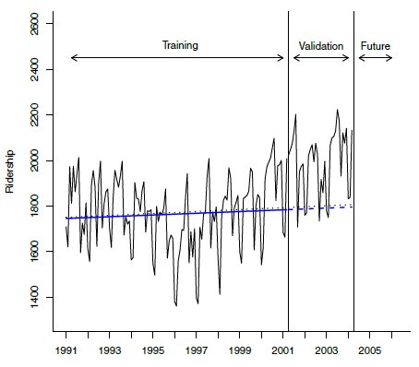
# fit exponential trend using tslm() with argument
# lambda = 0
train.lm.expo.trend <- tslm(train.ts ~ trend, lambda = 0)
train.lm.expo.trend.pred <- forecast(train.lm.expo.trend,
h = nValid, level = 0)
Exponential trend (dotted line) very similar to linear trend (solid line)

Slide 12
Polynomial Trend
Add additional predictors as appropriate
For example, for quadratic relationship add a t² predictor
Fit linear regression using both t and t²

Slide 13
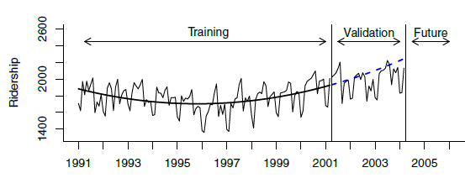
# fit quadratic trend using function I(), which treats an # object "as is".
train.lm.poly.trend <- tslm(train.ts ~ trend + I(trend^2))
summary(train.lm.poly.trend)
train.lm.poly.trend.pred <- forecast(train.lm.poly.trend,
h = nValid, level = 0)
Better job capturing the trend, though it over forecasts in validation period.
Next: we’ll try capturing seasonality.

Slide 14
Handling Seasonality
Seasonality is any recurring cyclical pattern of consistently higher or lower values (daily, weekly, monthly, quarterly, etc.)
Handle in regression by adding categorical variable for season, e.g.
Month | Ridership | Season
Jan-91 | 1709 | Jan
Feb-91 | 1621 | Feb
Mar-91 | 1973 | March
Apr-91 | 1812 | April
11, not 12, to avoid multicollinearity
# include season as a predictor in tslm(). Here it creates 11
# dummies, one for each month except for first season, January
train.lm.season <- tslm(train.ts ~ season)
summary(train.lm.season)

Slide 15
Final model, Amtrak data
Incorporates trend and seasonality
13 predictors
11 monthly dummies
t
t²
train.lm.trend.season <- tslm(train.ts ~ trend +
I(trend^2) + season)

Slide 16
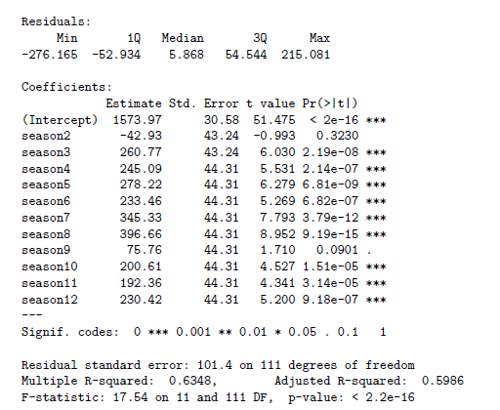
Output of full model

Slide 17
Autocorrelation
Unlike cross-sectional data, time-series values are typically correlated with nearby values (“autocorrelation”)
Ordinary regression does not account for this

Slide 18
Computing autocorrelation
Create “lagged” series
Copy of the original series, offset by one or more timer periods
Compute correlation between original series and lagged series
Lag-1, lag-2, etc.

Slide 19
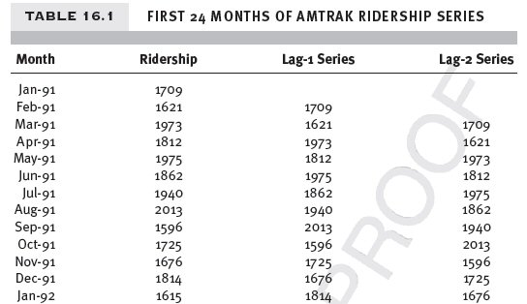
Amtrak – original series and Lag-1, Lag-2

Slide 20
Autocorrelation
Positive autocorrelation at lag-1 = stickiness
Strong autocorrelation (positive or negative) at a lag > 1 indicates seasonal (cyclical) pattern
Autocorrelation in residuals indicates the model has not fully captured the seasonality in the data

Slide 21
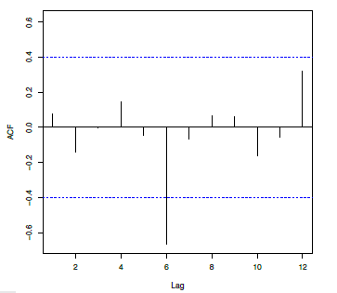
Compute & display autocorrelation for different lags, over 24 months:
ridership.24.ts <- window(train.ts, start = c(1991, 1),
end = c(1991, 24))
Acf(ridership.24.ts, lag.max = 12, main = "")
Strong negative correlation at 6 months shows seasonal pattern (high summer traffic, low winter)
The dotted lines are confidence bounds for judging statistical significance

Slide 22
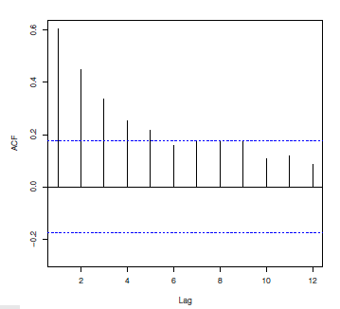
It is useful to examine autocorrelation for the residuals:
Strong autocorrelation from lag 1 on, but lag 6 no longer dominates.
Note: If you have correlation at lag 1, it will naturally propagate to lag 2, 3, etc., tapering off

Slide 23
Incorporating autocorrelation into models
Use a forecasting method to forecast k-steps ahead
Fit AR (autoregressive) model to residuals
Incorporate residual forecasts
Improved F_{t+k} = F_{t+k} + E_{t+k}

Slide 24
Choose order of the AR model
If autocorrelation exists at Lag-1, a Lag-1 model should be sufficient to capture lags at other periods as well
E_{t} = B₀ + B₁E_{t-1} + e
Where E_{t} is residual (forecast error) at time t

Slide 25
Adding ARIMA lag 1 - AR(1) - to earlier model…
# fit linear regression with quadratic trend and seasonality
# to Ridership
train.lm.trend.season <- tslm(train.ts ~ trend + I(trend^2) +
season)
# fit AR(1) model to training residuals
# use Arima() in the forecast package to fit an ARIMA model
# (that includes AR models); order = c(1,0,0) gives an AR(1).
train.res.arima <- Arima(train.lm.trend.season$residuals,
order = c(1,0,0))
valid.res.arima.pred <- forecast(train.res.arima, h = 1)

Slide 26
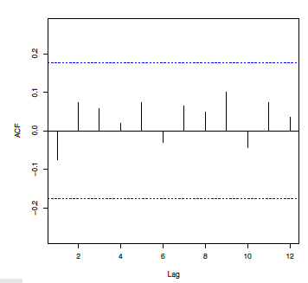
Plot autocorrelation of “residuals of residuals”
Autocorrelation is mostly gone – AR(1) has adequately captured the autocorrelation in the data:

Slide 27
Random walks
Before forecasting, consider “is the time series predictable?”
Or is it a random walk?
Do a statistical hypothesis test that slope = 1 in an AR(1) model (i.e. that the forecast for a period is the most recently-observed value)
If hypothesis cannot be rejected, series is statistically equivalent to a random walk (i.e. we have not shown that it is predictable).

Slide 28
Summary – Regression Based Forecasting
Can use linear regression for exponential models (use logs) and polynomials (exponentiation)
For seasonality, use categorical variable (make dummies)
Incorporate autocorrelation by modeling it, then using those error forecasts in the main model

